Slide 1




UNIFIED HEALTHCARE RECORDS & APPOINTMENT SYSTEM
A SECURE, CENTRALIZED DIGITAL PLATFORM FOR PATIENT MEDICAL DATA AND APPOINTMENTS
Team Name: HealthBridge
TEAM MEMBERS:
Manasa H N
Sthuthi Sheela
Shri Chandana S Y
Priyanka S Y

Slide 2


Problem Statement
Patients currently lack a unified and secure system to store, access, and share their medical records across different hospitals. This fragmentation leads to incomplete information during treatment, delays in diagnosis, and difficulty managing ongoing care. Additionally, patients struggle with inefficient appointment scheduling, limited visibility into doctor availability, inadequate emergency communication, and inconsistent tracking of prescriptions — all of which reduce the overall quality and coordination of healthcare.

Slide 3


Solution overview:
The proposed solution is a unified, secure digital healthcare platform that centralizes patient medical records and makes them accessible across all hospitals and healthcare providers. The system enables patients to easily store, manage, and share their health data with authorized professionals, ensuring continuity of care. It also integrates key healthcare services — including real-time doctor availability, streamlined appointment booking, emergency alert features, and comprehensive prescription tracking — into a single platform. This improves coordination between patients and providers, enhances treatment accuracy, reduces administrative delays, and creates a more efficient and responsive healthcare experience.

Slide 4


Key features:
  Centralized medical records
  Interoperable data sharing
  Real-time doctor availability
  Smart appointment booking
  Emergency alerts system
  Prescription and medication tracking
  Doctor and hospital dashboards
  Secure communication
  Advanced data security
  Analytics and insights

Slide 5

Core functional modules
Medical Records Module
  Centralized electronic health records
  Storage for scans, lab reports, and documents
  Permission-based sharing
  Version tracking & audit logs
Appointment Management
  Real-time doctor availability
  Smart scheduling
  Telemedicine booking
  Automated reminders
  Queue & check-in updates
Prescription & Medication Tracking
  Digital prescriptions
  Medication reminders
  Drug interaction alerts
  Pharmacy integration
  Refill notifications
Doctor & Hospital Dashboard
  Doctor profiles & schedules
  Patient history quick-view
  Patient flow analytics
  Digital prescription tools
Security & Compliance
  End-to-end encryption
  Multi-factor authentication
  Role-based access control
  Regular security audits
Emergency & Alert System
  SOS emergency button
  Critical patient tagging
  Alerts for doctors & hospitals
  Health event notifications

Slide 6


Technology used
  Frontend: React.js, HTML, CSS, JavaScript
  Backend: Spring Boot, Java
  Database: MySQL
  APIs: RESTful APIs for data exchange
  Authentication: JWT
  Deployment: AWS/Heroku/Docker (optional)

Slide 7
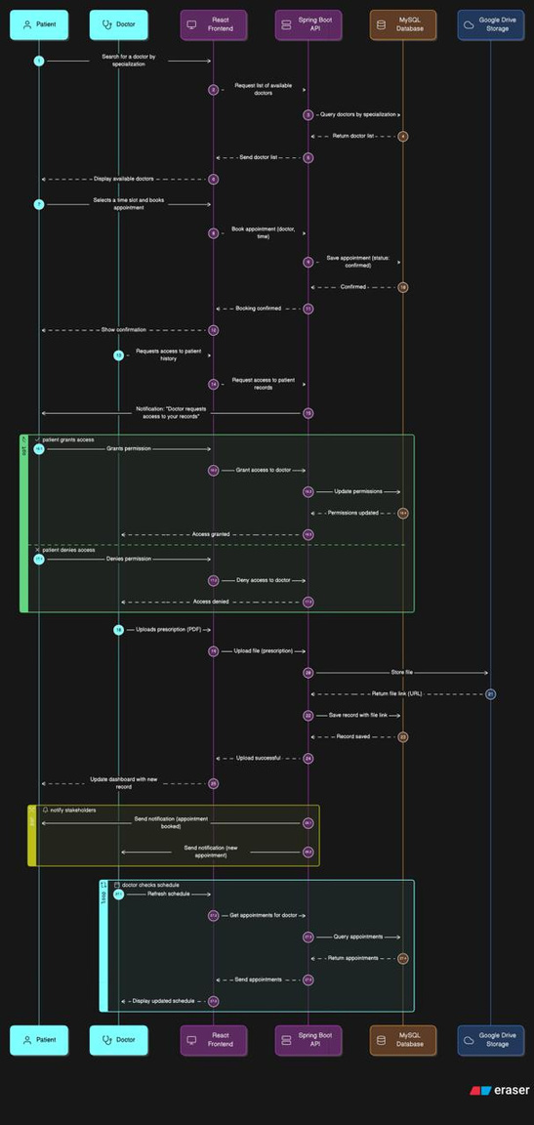
WorkFlow

Slide 8
THANK
YOU
Transforming healthcare through connected digital ecosystems

